Slide 1

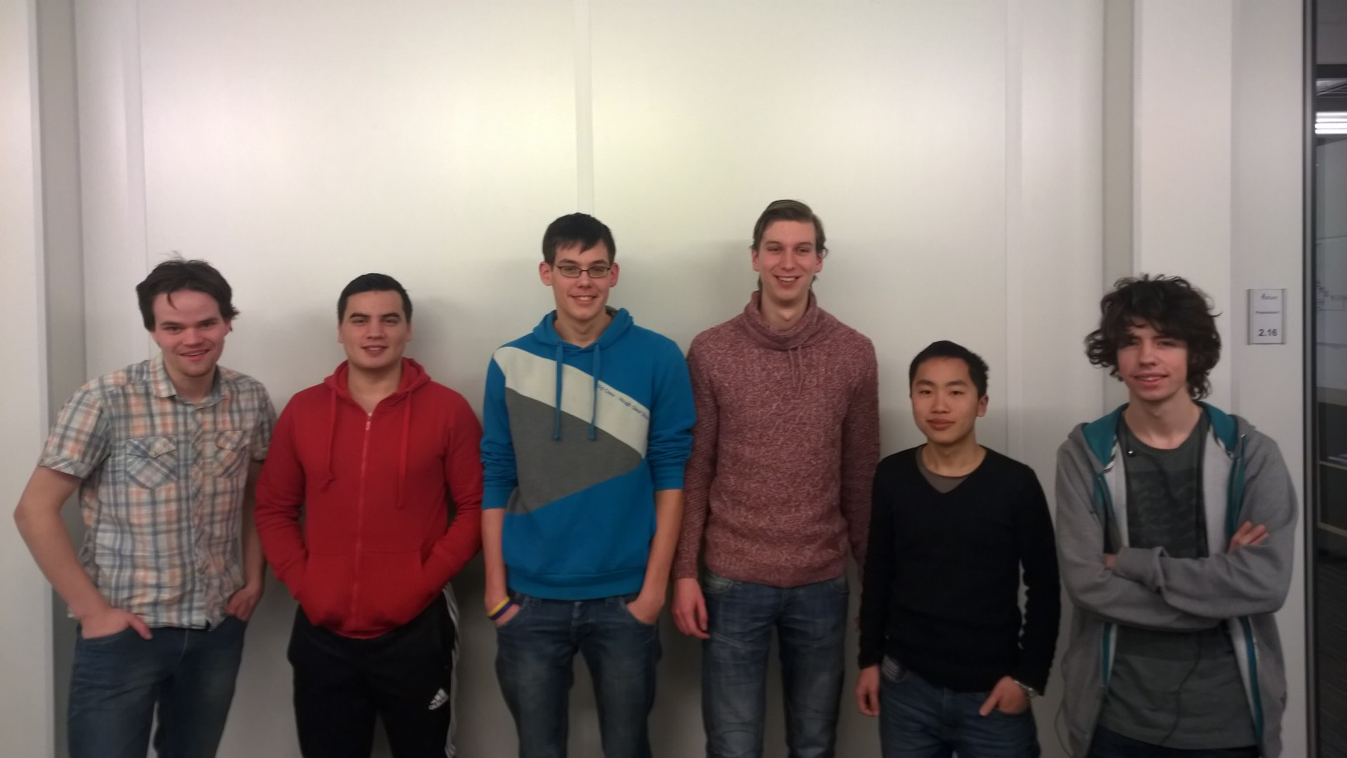
Surreal Gravity

Slide 2
Surreal Gravity
Level creator
Textures
Gravity switch
Networking
robots

Slide 3
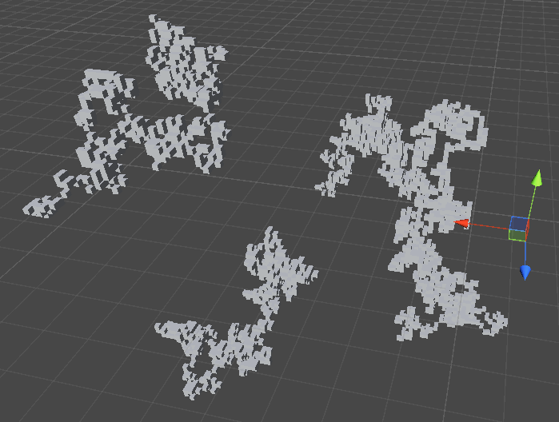
Level creator
Proceduraly generated
Smoothing filter

Slide 4
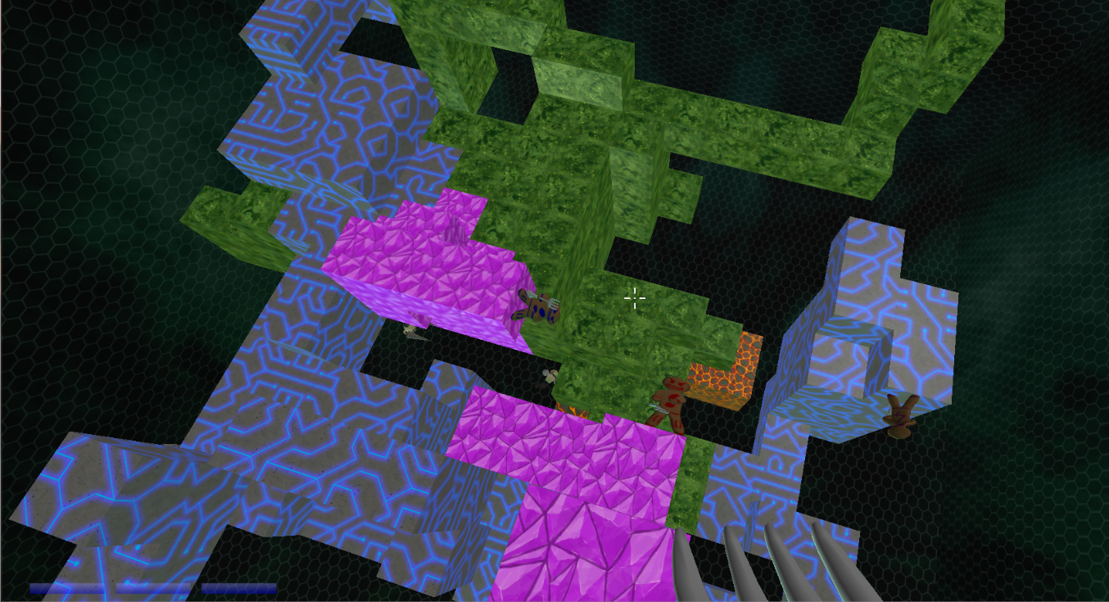
Level creator
Proceduraly generated
Smoothing filter

Slide 5
Textures
Handdrawn
Tileable combinations

Slide 6
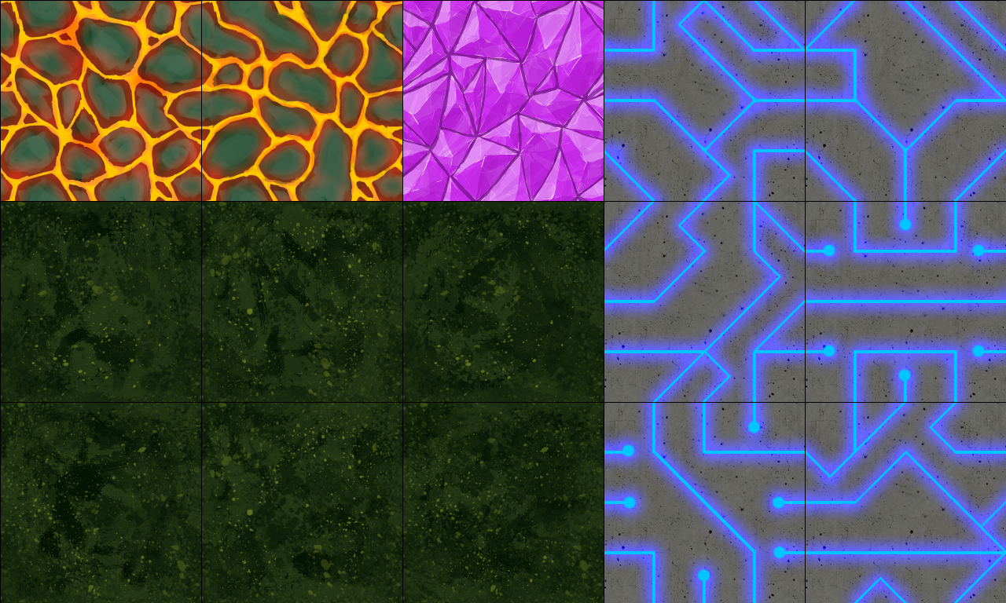
Textures
Handdrawn
Tileable combinations

Slide 7
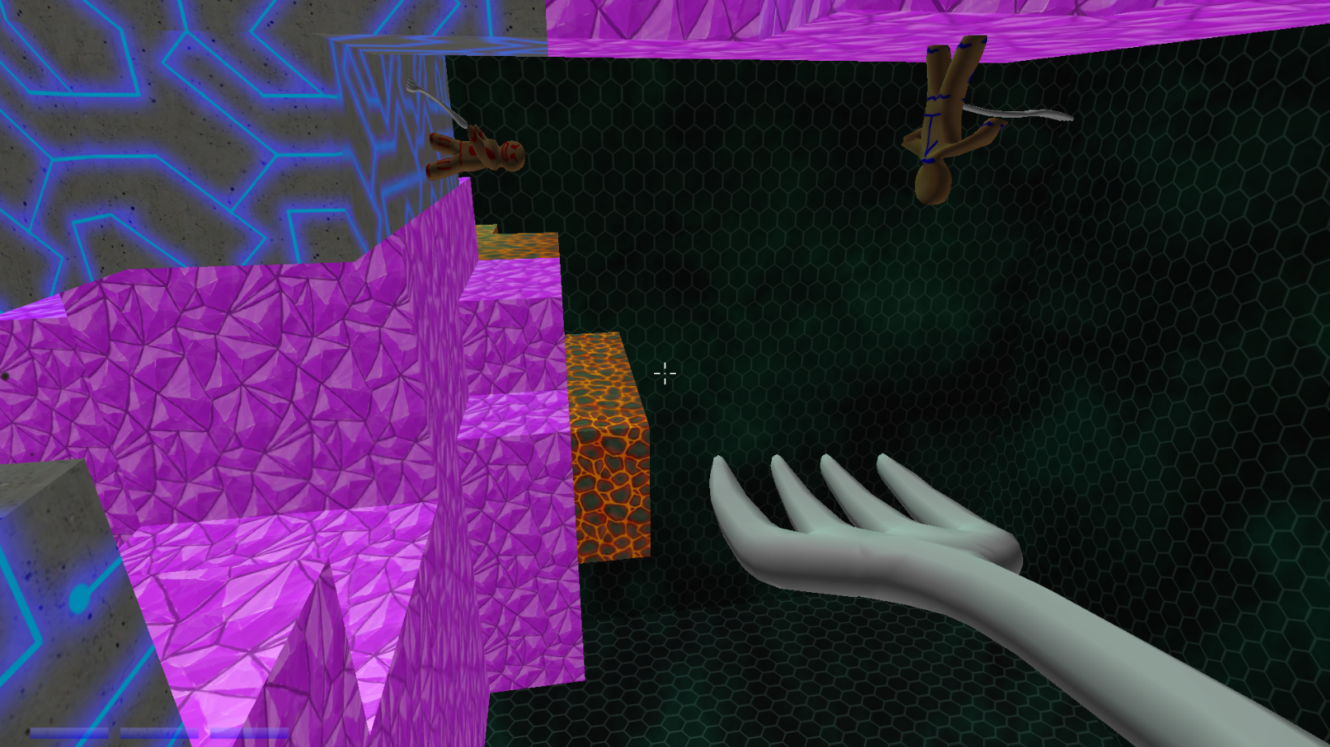
Gravity Switch
Creative gameplay
Interesting visuals

Slide 8
Networking
Network connection
Unity MasterServer
Network synchronisation
Components offline -> Online
Locations, Robots, Scores etc.

Slide 9
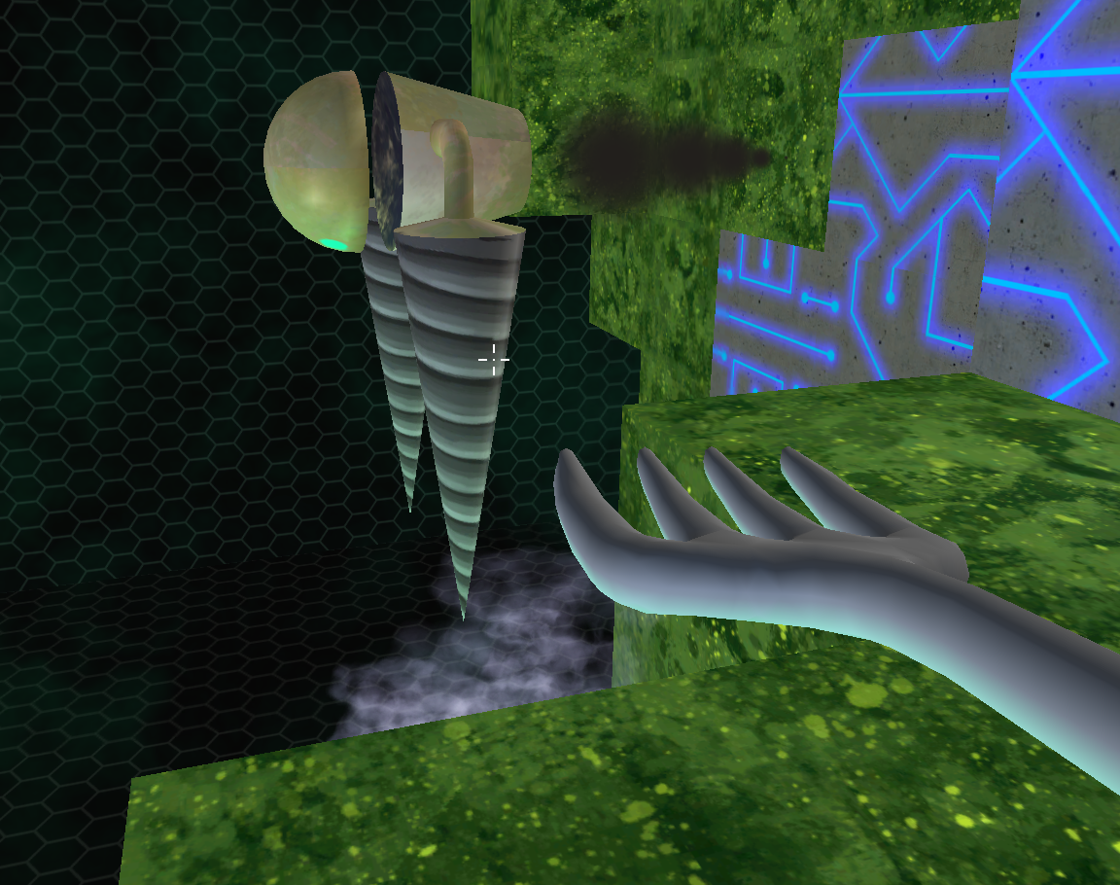
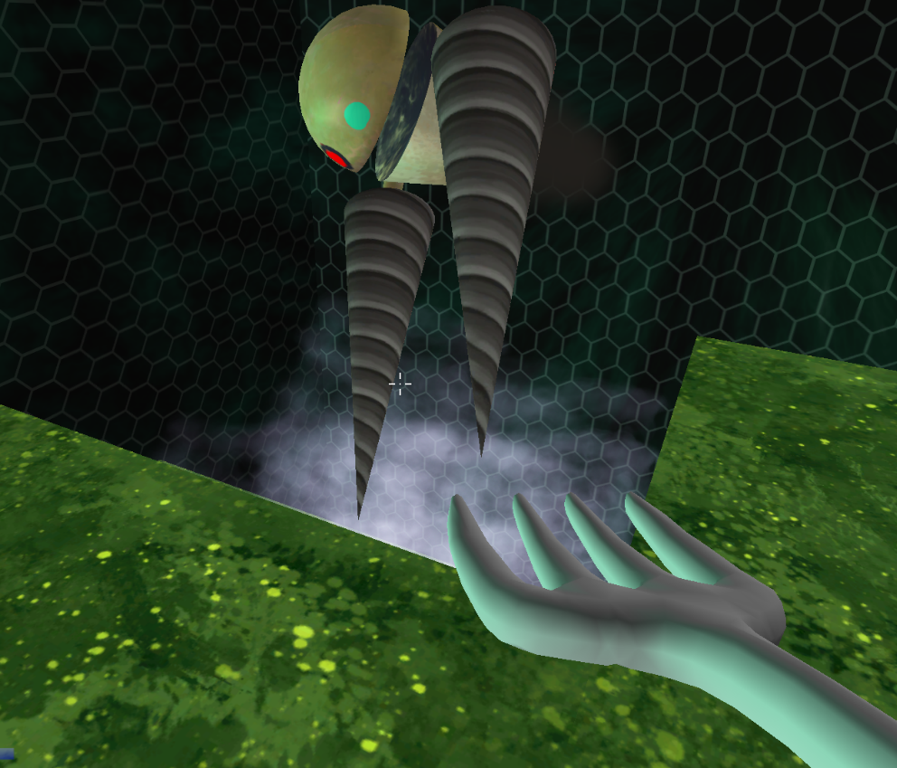
Robots
Selection
Pathfinding - A*
Movement

Slide 10

Enjoy!

